Slide 1
UNIVERSITY OF RWANDA
COLLEGE OF SCIENCE AND TECHNOLOGY
…………………………………………
MODULE TITLE :
ORIENTATION TO ENTREPRENEURSHIP AND INNOVATION
ACADEMIC YEAR 2025-2026
By:
Ms. SUMWIZA Kellen
Contact:0788506211
Email: kellensumwiza@gmail.com

Slide 2
1. ORIENTATION TO ENTREPRENEURSHIP
Lesson 1: Let’s get started
Lesson 2: Explore E-cells on campus
Lesson 3: Listening to some Success stories
Lesson 4: Characteristics of Successful Entrepreneurs
Lesson 5: Effective Communication
Lesson 6: Design thinking/Process for customer delight
Lesson 7: Sales skills to become an effective Entrepreneur
Lesson 8: Managing risks and learning from failures
Lesson 9: Are you ready to be an Entrepreneur?

Slide 3
1. IMPORTANT TERMINOLOGIES
i. Entrepreneurship
Entrepreneurship can be defined as a creative process or quality that a person has to generate business ideas, scan and evaluate the business environment, identify viable business opportunities, choose the best and then exploit them by starting a new business or expanding an already existing one.
ii. Entrepreneur
a person with creative and innovative abilities and qualities to generate business ideas, identify business opportunities and then exploit them by starting and operating businesses with a view of making profit. a person who starts a new business and usually risks his own money to start the venture.

Slide 4
Terminologies cont’d…
iii. Creativity
Creativity is defined as the tendency to generate or recognize ideas, alternatives useful possibilities.
It is the ability to come up with new ideas and to identify new and different ways of looking at a problem and opportunities
iv. Innovation
Innovation is the implementation of new ideas at the individual, group or organizational level

Slide 5
Terminologies cont’d…
v. Business Idea
A business idea is a concept which can be used for commercial purposes. It typically centers on a commodity or service that can be sold for money.
Good business ideas:
Solve a problem
Offer a better, cheaper way
Surrounding opportunities
Simple and practicable
Can be delivered quickly
Anticipate trends and exploit better growing markets

Slide 6
Terminologies cont’d…
vi. Resources
A resource is any requirement or input in the operation and production processes that determine the nature and quality of output. Resources have economic values and can be expressed in monetary terms.
vii. Technology
Technology refers to the way, the means, the method and techniques used in production of a commodity or a provision of a service including the process of production, the machines, equipment's and tools involved in the process.

Slide 7
Terminologies cont’d…
viii. Enterprise
This is a business undertaking/organization or entity that entrepreneurs operate with an objective of making profit.
ix. Entrepreneurial activities
These are gainful activities that entrepreneurs engage themselves in by operating a business.
x. Small business
This is a business independently owned, not dominant in its own field, does not engage in innovative activities, has a small number of employees, has little output and turnover and whose investment is not large.

Slide 8
Terminologies cont’d…
xi. Self employment
This is working for one self and earning a living out of it. It is the opposite of salaried or paid employment where one works for someone else.
It is also important to note that most entrepreneurs are self employed and their entrepreneurship in most cases is linked to self employment.
xii. Business environment
The business environment consists of almost any factor likely to have an impact on the establishment, development, survival and expansion of a business enterprise.
▪ The environment again is very complex and dynamic.
▪ What entrepreneurs need to do is to study the environment, understand how it affects them and then look for ways of coping with them.

Slide 9
Terminologies cont’d…
xiii. Business incubation
It involves provision of support for a new business through the early stages of development. This helps them to establish and accelerate their growth and success and then graduating them when they reach a certain level of maturity.
It supports business start-ups by providing entrepreneurs with appropriate resources, services and an enabling environment in which they can flourish.

Slide 10
Examples of Business incubations
HANGA Hub is an open space and a centre of gravity for young entrepreneurs and innovators needed to build startups with cool tech solutions, products and services.
Rwanda FinTech Hub
African Impact Initiative
Startup Africa Roadtrip

Slide 11
Classification of entrepreneurs on the basis of type of business
Business entrepreneur:
Convert ideas into reality; deal with both manufacturing and trading aspect of business (Small trading and manufacturing business). High profile examples, Elon Musk, bill gate, Sina Gérard – Founder of Urwibutso Enterprises etc
Trading entrepreneur:
Undertakes trading activities; concerned with marketing (Domestic and international level). Example: Jeff Bezos, the founder of Amazon, started as a trading entrepreneur by establishing an online bookstore.

Slide 12
Cont’d……
Industrial entrepreneur:
Undertakes manufacturing activities only; new product development etc (textile, electronics, etc). E.g Manish Pandey , Founder of Sulfo Rwanda Industries
Corporate entrepreneur:
Interested in management part of organization; exceptional organizing, coordinating skills to manage a corporate undertaking.
e.g Steve Jobs : founder of products like the iPhone, iPad, and Mac, transformed Apple into a global tech leader, Patrick Buchana: founder of Tap&Go which is the public transport payment system in Rwanda

Slide 13
Agricultural entrepreneur:
Production and marketing of agricultural inputs and outputs (Dairy, horticulture, forestry)
E.g Jean Bosco Nzeyimana :Founder of Habona Ltd, transforming agricultural and forestry waste into biogas and organic fertilizers.

Slide 14
Lesson 1: Let’s Get Started
Learning Objectives:
Form teams that students will work with for the entire duration of the course.
Learn how entrepreneurship has changed the world.
Learn what is entrepreneurship.
Identify six entrepreneurial myths and uncover the true facts.
Learn how entrepreneurship has changed your country through a class discussion.

Slide 15
Let’s Get Started
Let's Form Teams (youtube.com)
Let's Form Teams (youtube.com)
When’s Your Birthday? a warm-up exercise
Let every one share business idea
From there we form teams

Slide 16
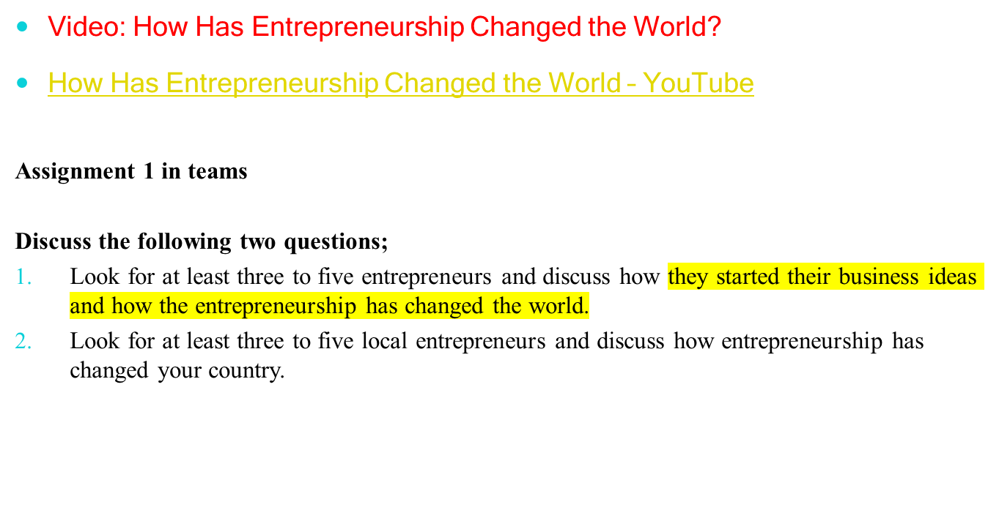
how has entrepreneurship changed the world.

Slide 17
Give your answers with reference to the following questions.
Name some entrepreneurs who made their mark on your country.
Do you think they were only seeking money?
What do you think could be the one big problem they faced while trying to start a business in your country?
What distinguished these people from others?
Do you think that these entrepreneurs have done anything for their country?

Slide 18
how has entrepreneurship changed the world.
Entrepreneurship has had a profound impact on the world in numerous ways, shaping economies, societies, and cultures. Here are some of the ways entrepreneurship has changed the world:
Economic Growth and Job Creation: Entrepreneurship drives economic growth by creating new businesses, industries, and jobs. Entrepreneurs identify market opportunities, innovate, and invest resources, leading to the creation of wealth and employment opportunities.
Innovation and Technological Advancement: Entrepreneurship is a primary driver of innovation and technological advancement. Entrepreneurs develop new products, services, and technologies that improve people's lives, increase productivity, and transform industries.

Slide 19
Social Impact and Change: Social entrepreneurship addresses social and environmental challenges by applying entrepreneurial principles to create innovative solutions. Social entrepreneurs develop sustainable business models that tackle issues such as poverty, healthcare, education, and environmental sustainability.
Globalization and Connectivity: Entrepreneurship has facilitated globalization by enabling businesses to reach global markets and connect with customers and partners around the world. This interconnectedness has led to the exchange of ideas, cultures, and resources, driving economic development and cultural exchange.

Slide 20
Rise of Start-up Culture and Ecosystems: Entrepreneurship has fueled the rise of start-up culture and ecosystems in cities around the world. These ecosystems consist of entrepreneurs, investors, mentors, accelerators, and other stakeholders who support and nurture entrepreneurial ventures, fostering innovation and growth.e.g Kigali innovation city
Digital Transformation: The advent of the internet and digital technologies has democratized entrepreneurship by lowering barriers to entry and enabling entrepreneurs to start and scale businesses with minimal resources. Digital entrepreneurship encompasses e-commerce, digital marketing, online education, and other online businesses that have transformed industries and markets.

Slide 21
Cultural Influence and Inspiration: Successful entrepreneurs often become cultural icons and sources of inspiration for aspiring entrepreneurs. They embody the entrepreneurial spirit of innovation, resilience, and determination, inspiring others to pursue their own entrepreneurial dreams and make a positive impact on the world.

Slide 22
Six Entrepreneurial Myths
1. Entrepreneurs are born, not made.
2. Individuals start companies.
3. Entrepreneurs are smartest people in the room.
4. All leaders are charismatic(attractive)and their charisma is the key factor in success.
5. Entrepreneurs love risks.
6. Entrepreneurs are undisciplined.
Six Myths of Entrepreneurship (youtube.com)

